Slide 1
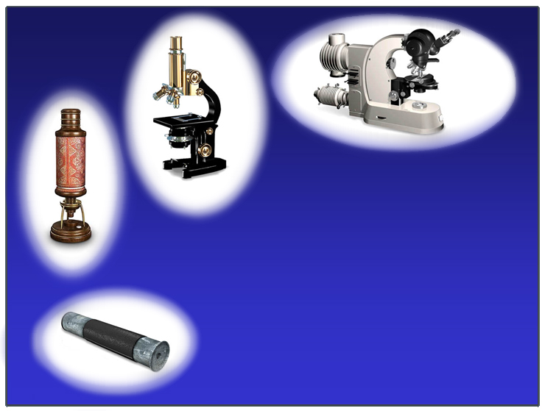
1960
1930
1680
Optical Microscopy
1515

Slide 2

Optical Microscopy
Micro ---- "small"
Skopeîn --- "see"
Pollen
40 µm
Human Hair
80 µm
Lymphocyte
7 µm
Escherichia coli
2 µm
Viruses
0.02 -0.3 µm

Slide 3
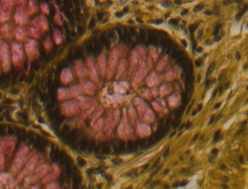
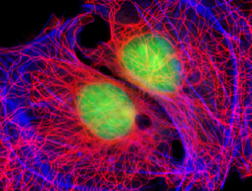
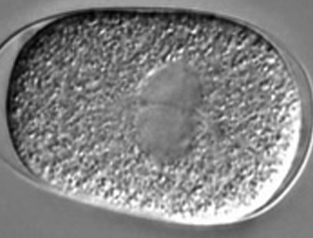
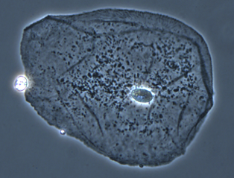

Optical Microscopy
Brightfield
Fluorescent
DIC
Phase contrast
Refraction
Phase shift
Absorption
Fluorescence
Polarization

Slide 4
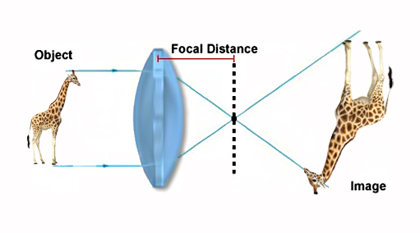
Magnifying
B
F
F
A₁
A
O
B₁

Slide 5
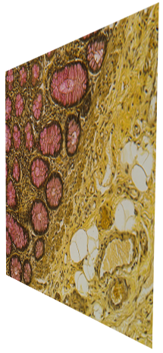

Magnifying

Slide 6
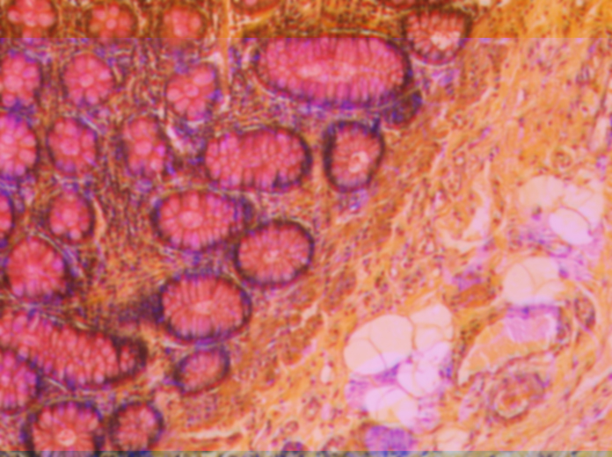
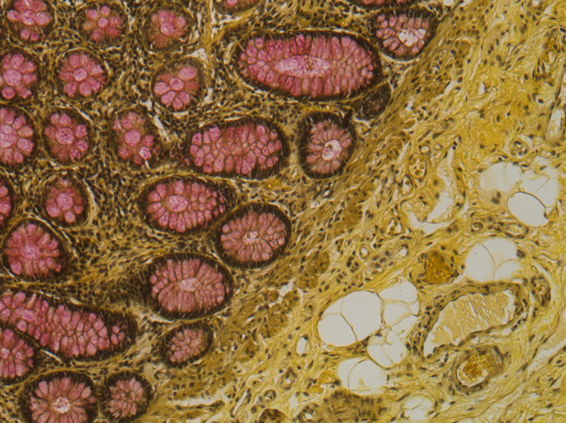
Magnifying

Slide 7
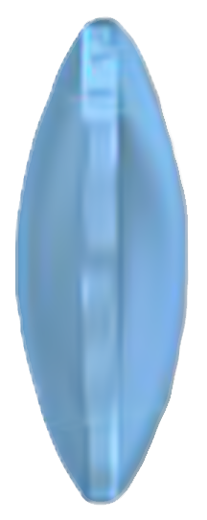
Lens

Slide 8
Chromatic aberrations
  Chromatic aberrations arise from variations in the refractive indices of the wide range of frequencies in visible light

Slide 9
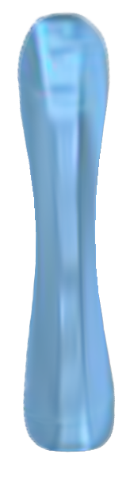
Chromatic aberrations
Concave
Convex

Slide 10
Geometrical or Spherical aberrations
Aberrations are related to the spherical nature of the lens

Slide 11
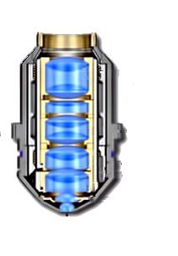
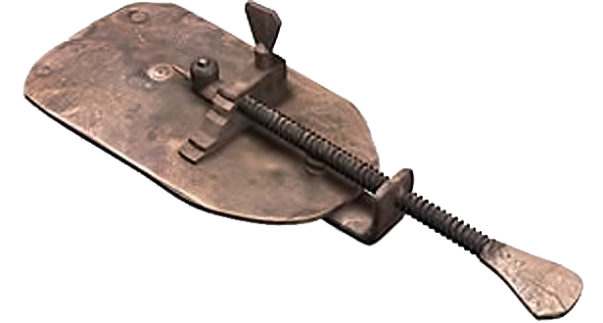
Objectives
Planapochromat
$uper corrected
Lens
Triplet
Group
Lens
Triplet
Group
Lens
Doublet
Groups
Miniscus
Lens
Hemispherical
Front Lens
Leeuwenhoek 1680
Zeiss 2000

Slide 12


Optical aberrations

Slide 13
Immersion Oil
Refractive Index n =
C
v
c - the speed of light in vacuum
v - the speed of light in the substance
Glass n = 1.52
Air n = 1.000
Immersion Oil
n = 1.515

Slide 14
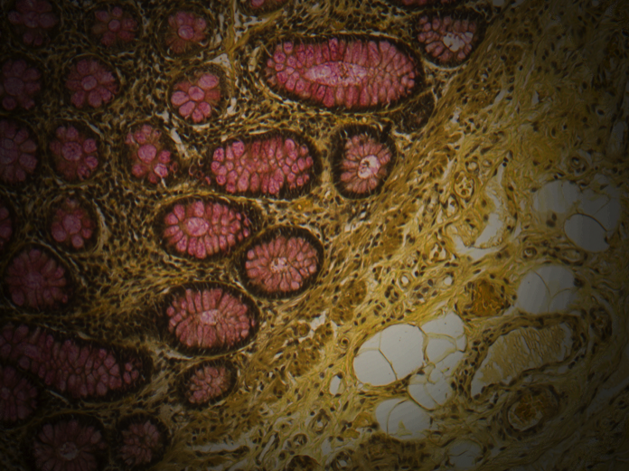
Lighting

Slide 15
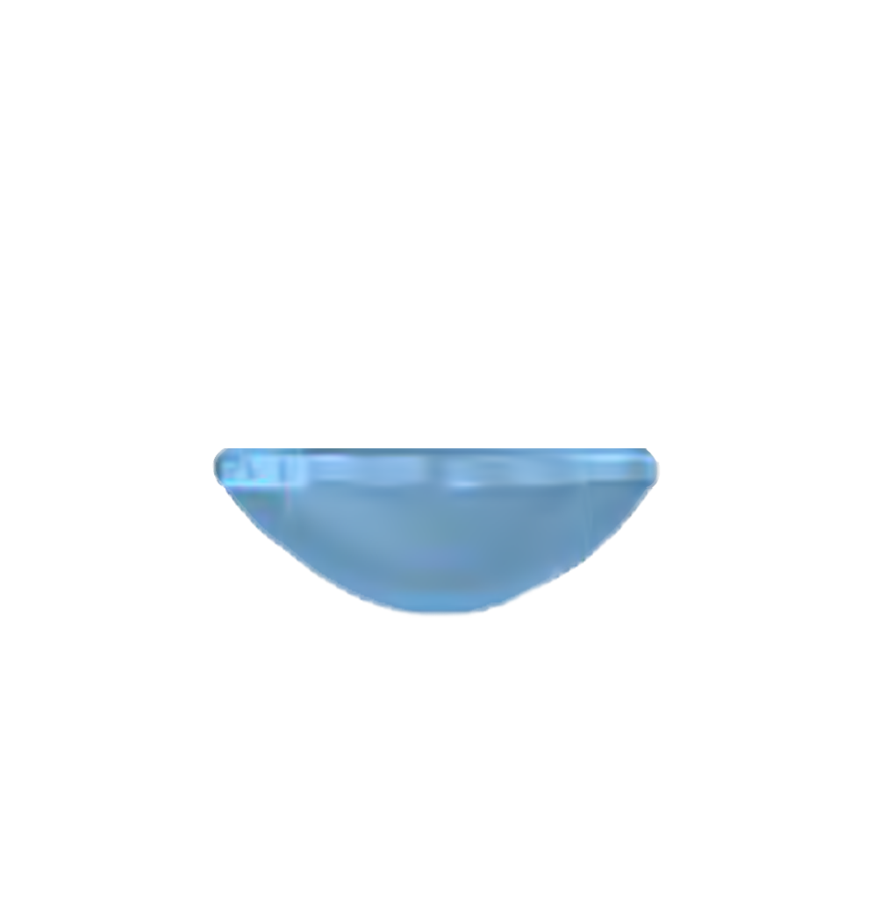
critical to quantitative microscopy
Lighting
CONDENSER
Daylight balancing filter
Neutral Density filter

Slide 16
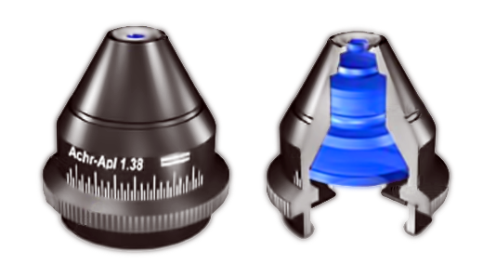
Lighting
Aplanatic-Achromatic
CONDENSER
Condencer
Top
Lens
Internal
Lens
Elements
Aperture
Diaphragm

Slide 17
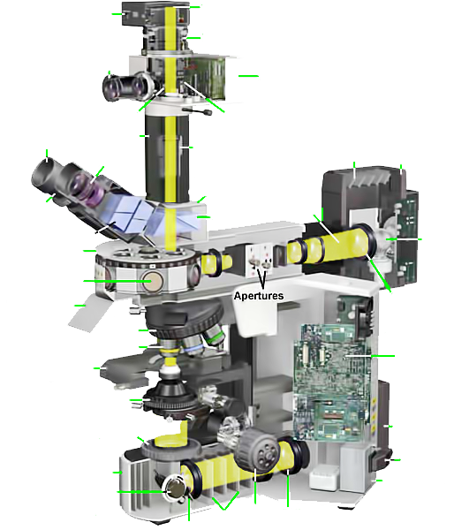
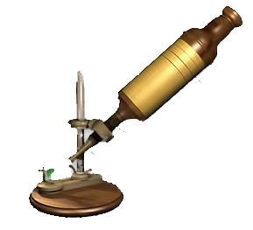
Microscope
Camera
Black Box
Film Plan
Focusing
Telescope
Electrical Contacts
Automatic
Exposure
Monitor
Shutter
Light
Sensor
Rubber
Eyecup
Extension
Tube
Cooling
Vents
Episcopic
Lamphouse
Projection
Eyepiece
Eyepiece
Lenses
Trinocular
Head
Eyepiece
(Ocular)
Shutter
Prisms
Beamsplitters
Lamp
Vertical
Illuminator
Barrel
Dichroic
Filters
Breathshield
Collector
Lens
Focusing Screw
Nose-
piece
Objective
Objective
Microscope
Control
Circuit
Board
Mecanical
Stage
Condenser
Diascopic
Lamphouse
Field
Diaphragm
Hooke 1670
Line
Cord
Base
Illumination
Intensity
Adjustement
Transformer
Filters
Focus
Knob
Collector
Lens
Mirror
Olympus BX 2000

Slide 18
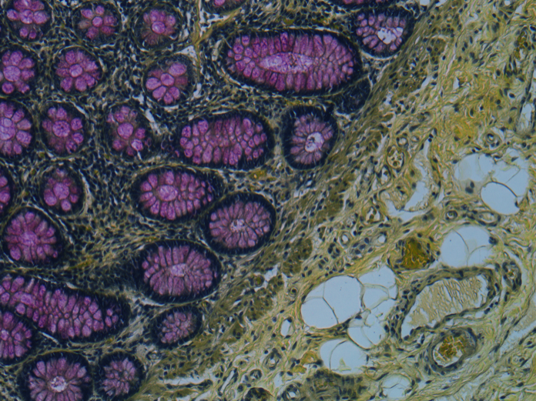
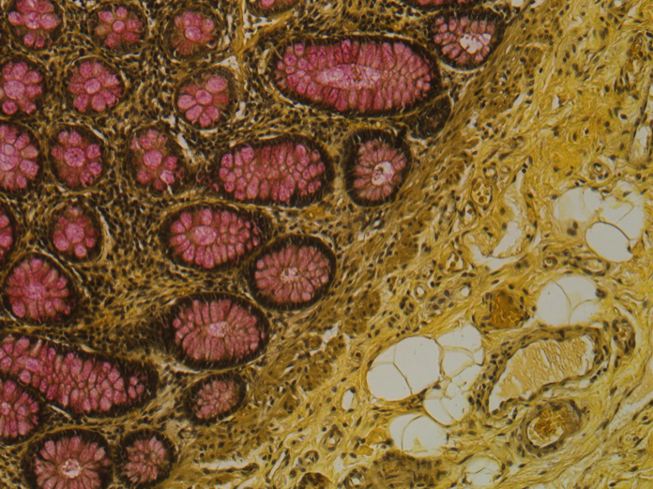
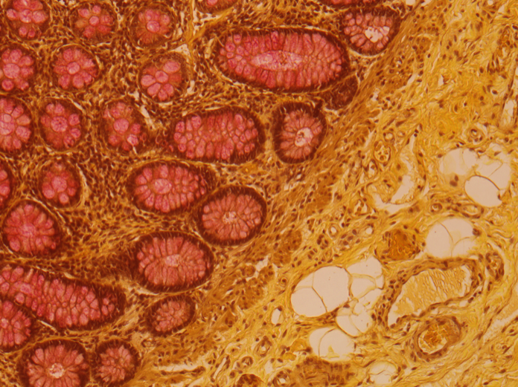
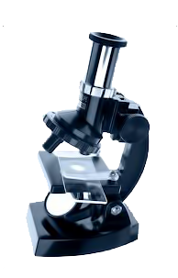
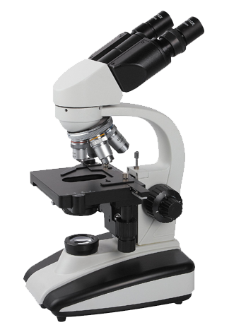
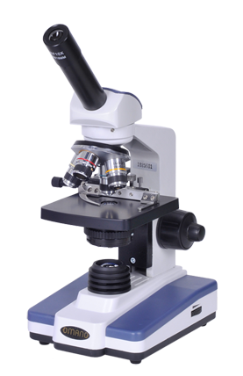
Color Fidelity

Slide 19
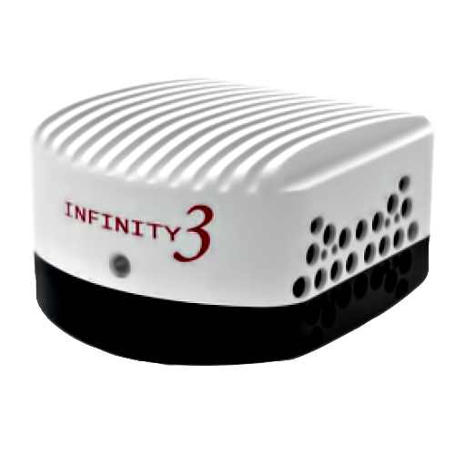
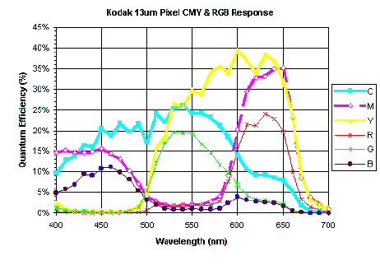
Color Fidelity
CCD Detector

Slide 20
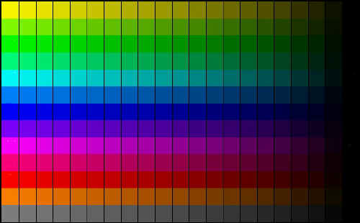

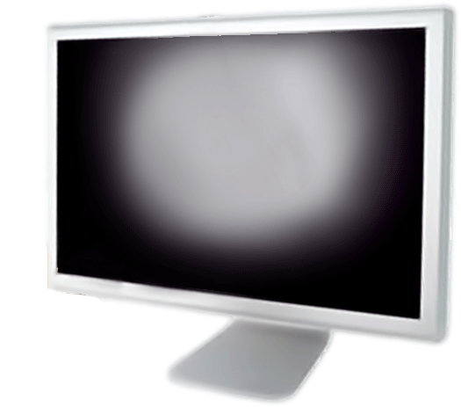
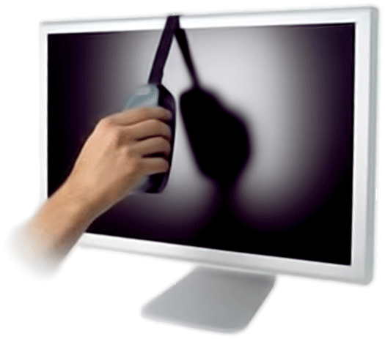
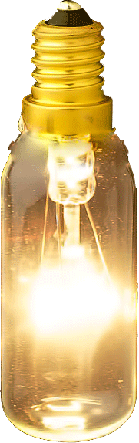
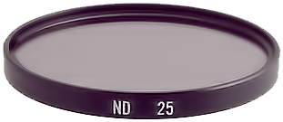
Color Fidelity
Calibration Slide
Monitor Calibration

Slide 21
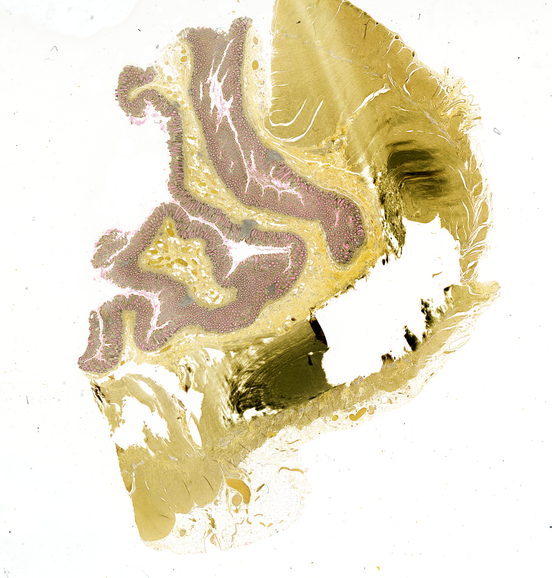
Brightfield
Mucicarmine stain

Slide 22
Optical Microscopy
Brightfield
Fluorescent
DIC
Phase contrast
Refraction
Phase shift
Absorption
Fluorescence
Polarization

Slide 23


Fluorescence
Jablonski
diagram
400 nm
450 nm

Slide 24

Fluorescence
Incoming
photon
N
M
L
K
Fluorescence

Slide 25
Light-Tissue interaction
Fixation (or not)
Stain
RAMAN
Fluorescence
AutoFluorescence
Absorbance

Slide 26
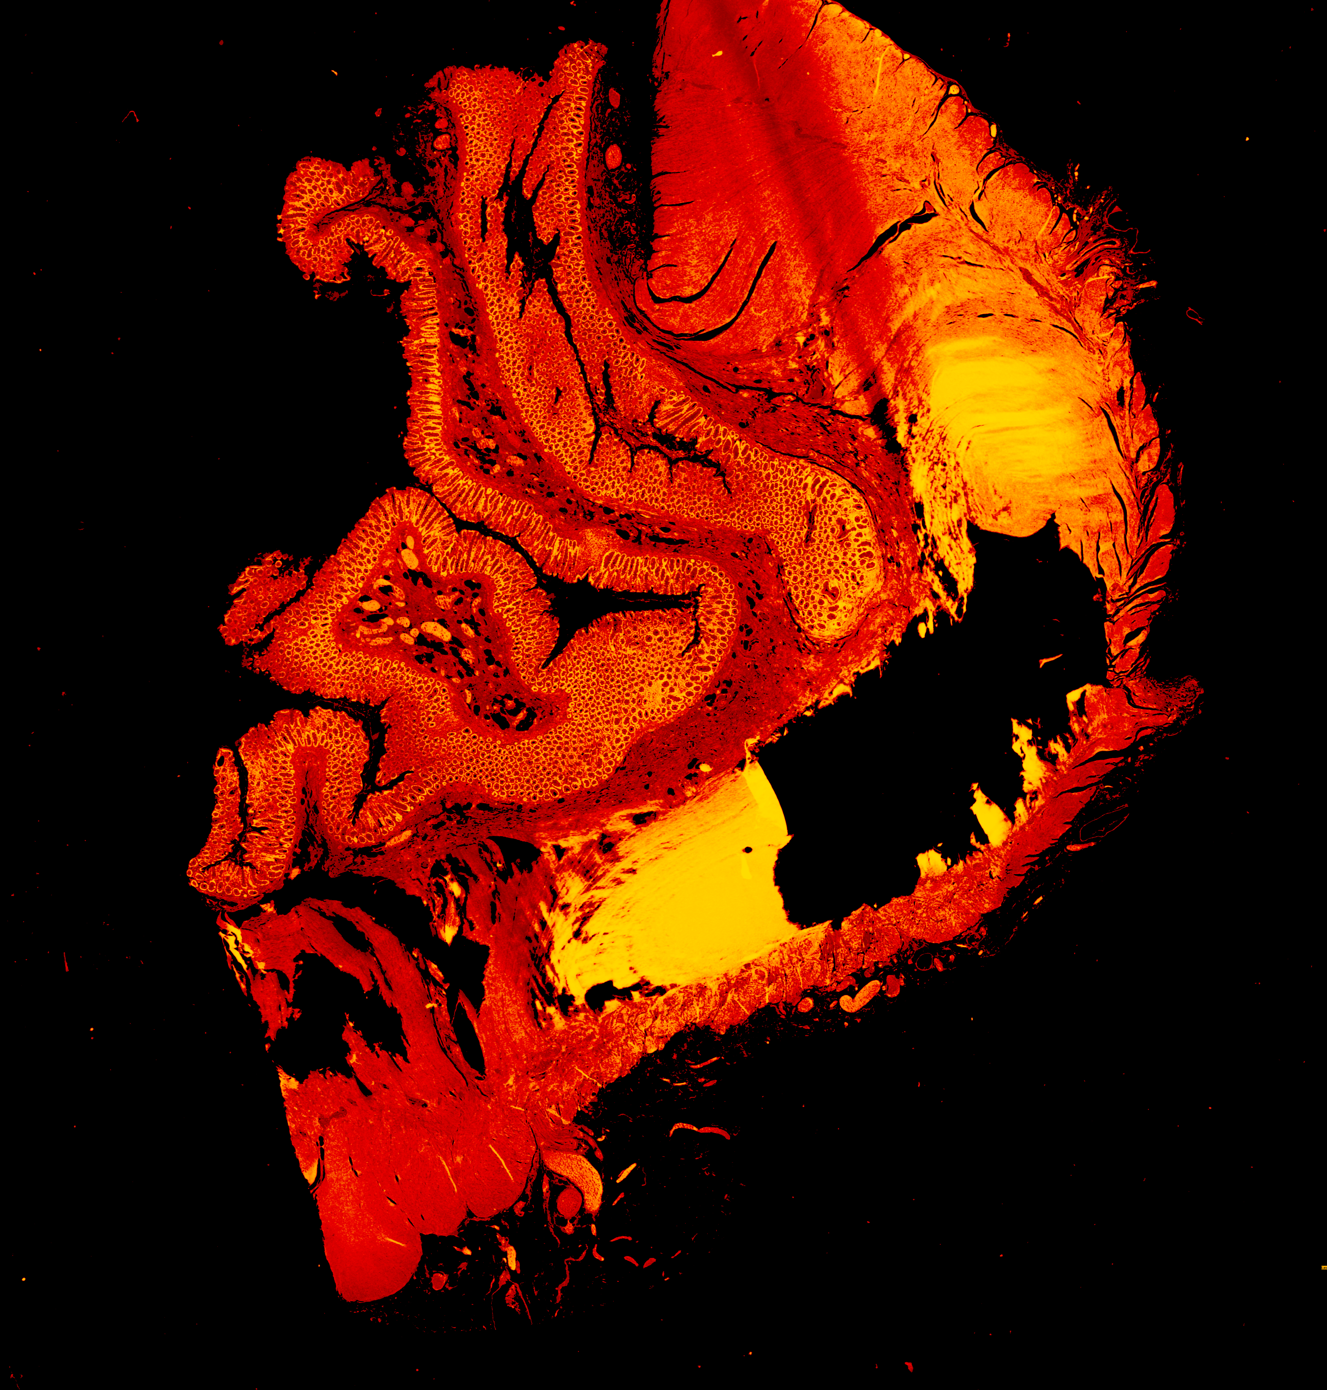
Fluorescence
Mucicarmine stain

Slide 27
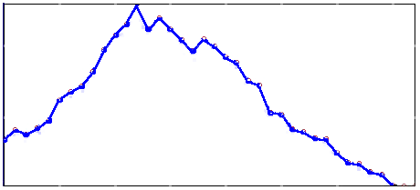
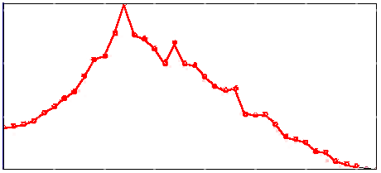
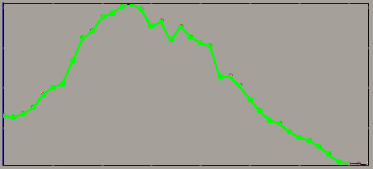
Fluorescence
Mucicarmine stain

Slide 28
Stain -Tissue interaction
Tissue
_
_
Quenching
+
+
Stain
FRET
Ionic
bonds
Hydrogen
bonds
Van der Waals
forces
Covalent
bonds
Fluorescence-lifetime
changes
electron delocalization
Fluorescence spectra modulations
characterize the molecular microenvironment adjacent to ...

Slide 29
Fluorescence
Nearest-Neighbor classification
Local Discriminant Bases
Minimum Noise Fraction Transformation
Complete Linear Spectral Unmixing
Principal Component Transformation
Spectral classifier
Unmixing-based constrained nonnegative matrix factorization
Hierarchical fusion using vector quantization
1BT Based Band Selection
Spectral Weighting Envelopes
Spectral Angle Mapper
Mucicarmine stain

Slide 30
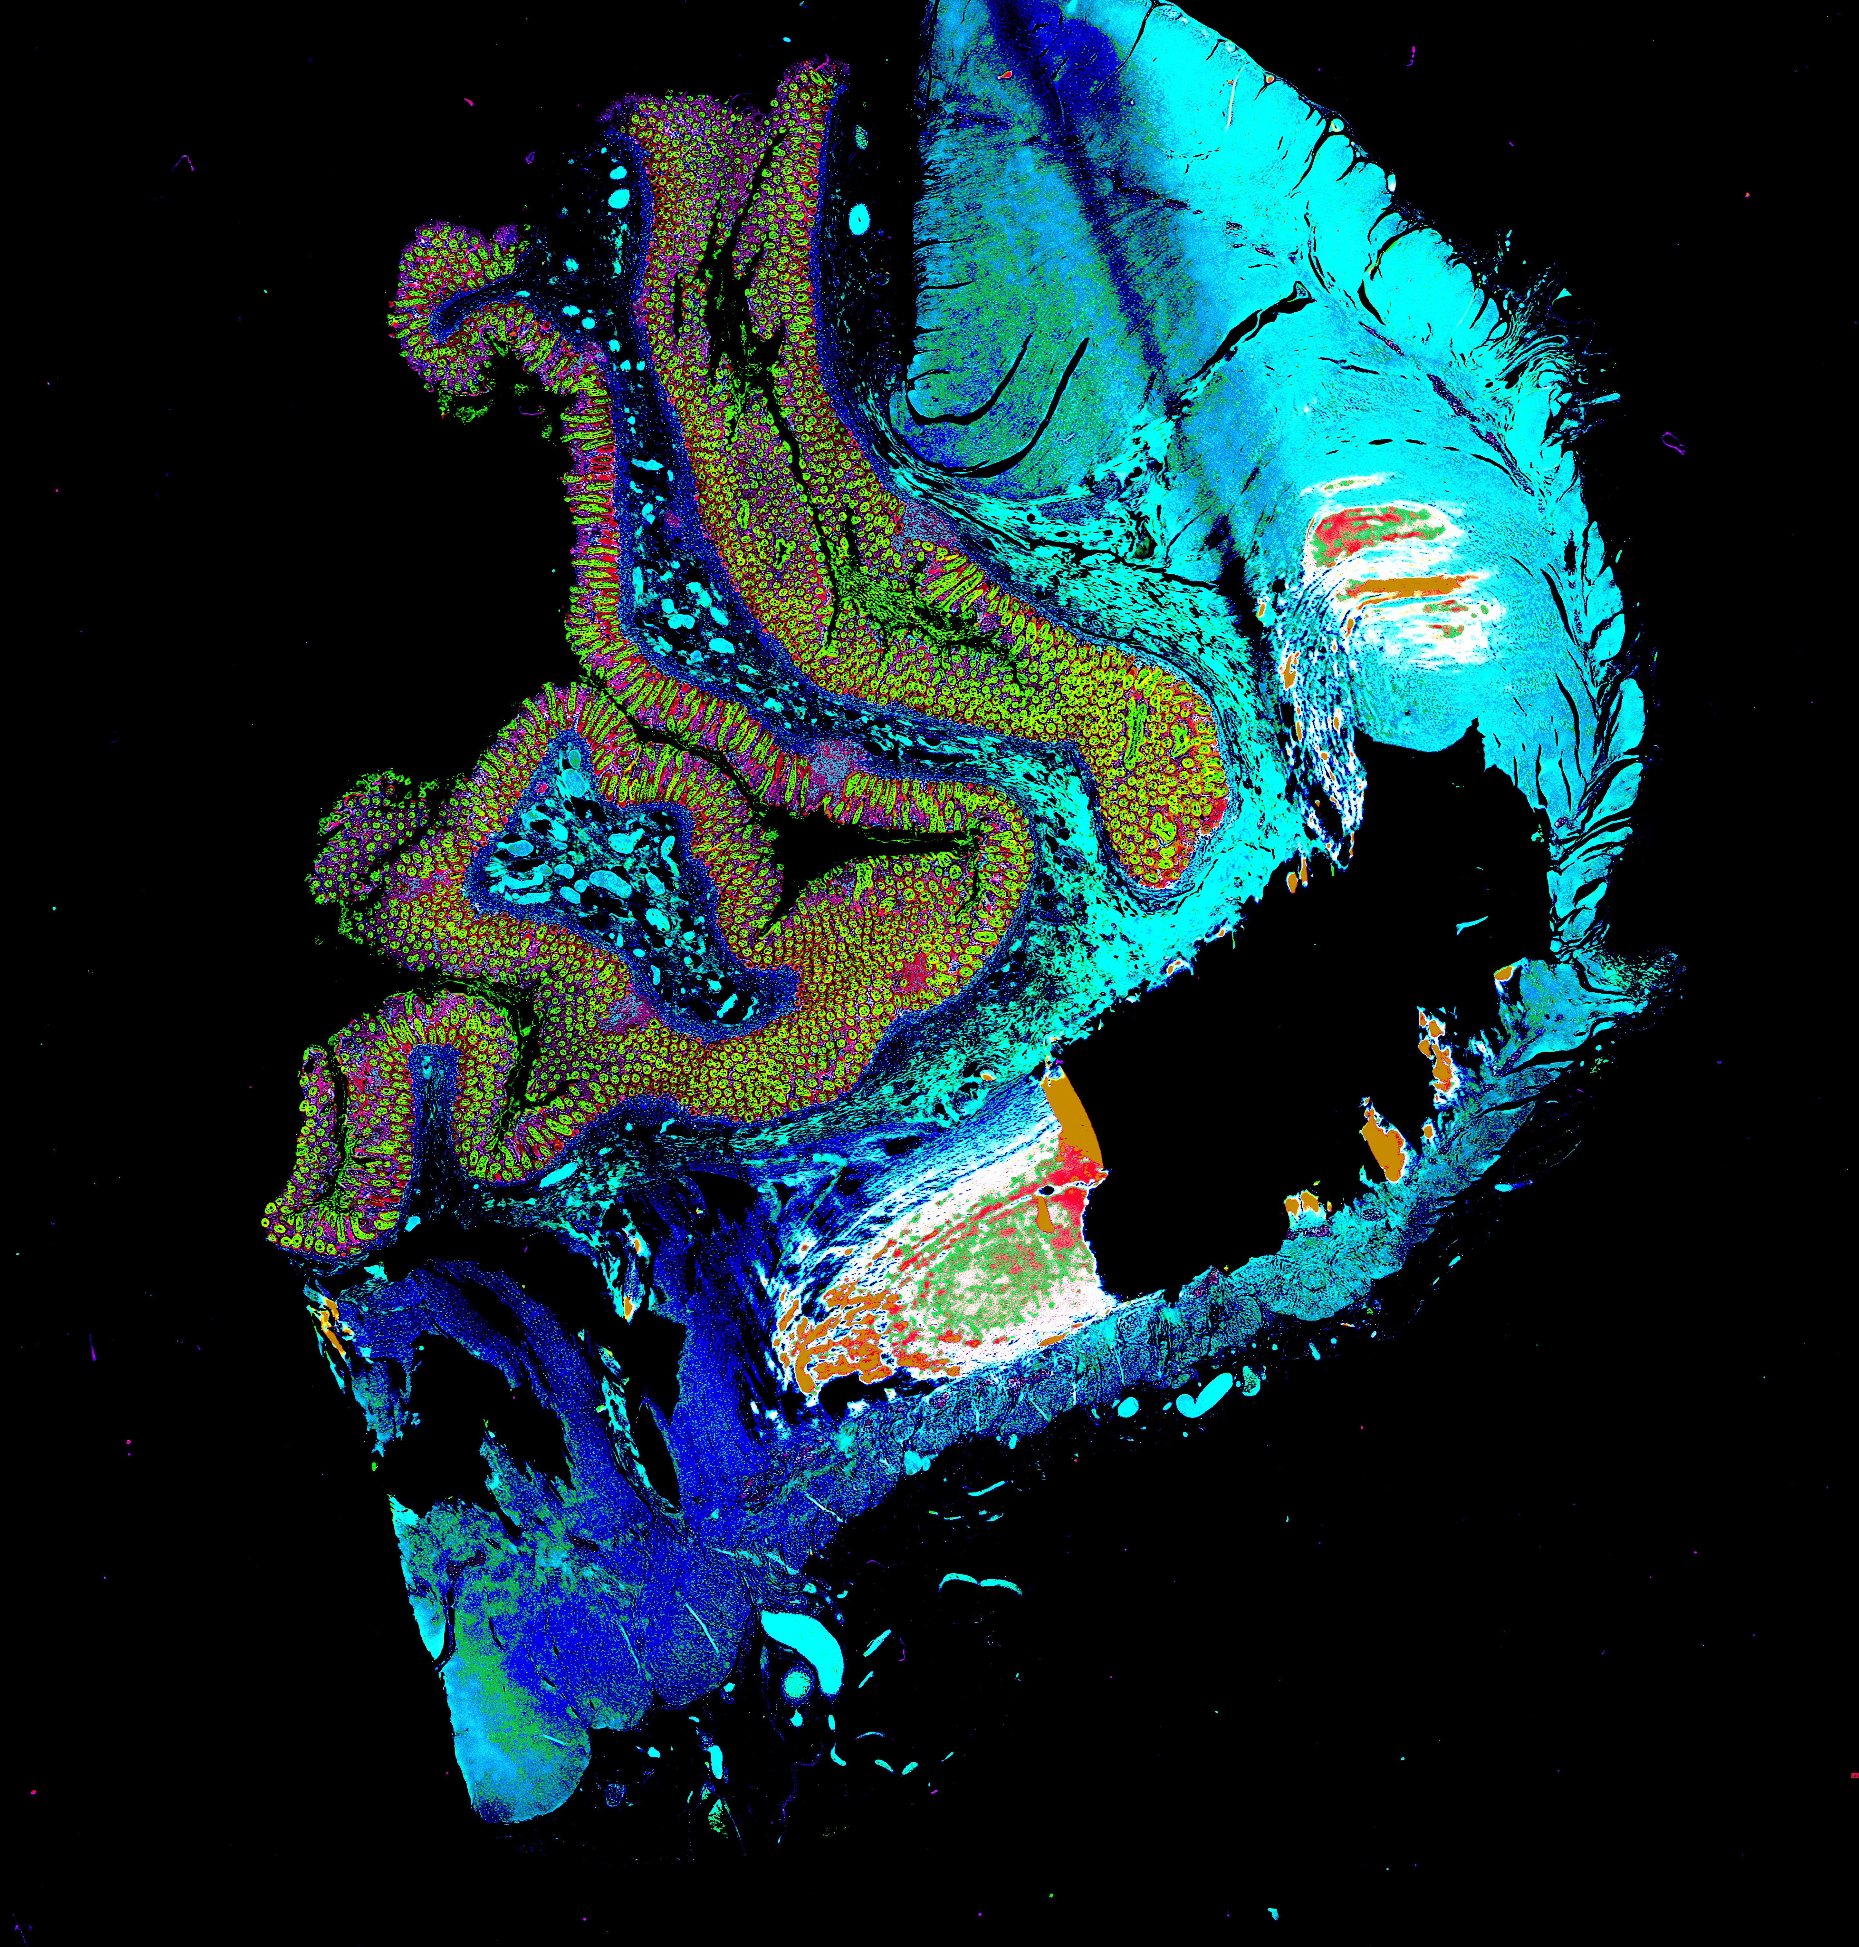
Hyperspectral
Notes:
Journal of Biomedical Optics 19(1), 010901 (January 2014)
Medical hyperspectral imaging: a review

Slide 31


Specimen Thickness

Slide 32

Point Spread Function
Z
Working distance

Slide 33
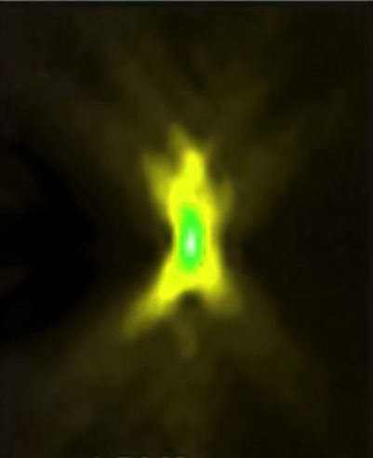
Point Spread Function
PSF describes the imaging system response to a point input
Z
In microscopy the point spread functions is asymmetric due to lens imperfections

Slide 34





Deconvolution
Optical sectioning

Slide 35
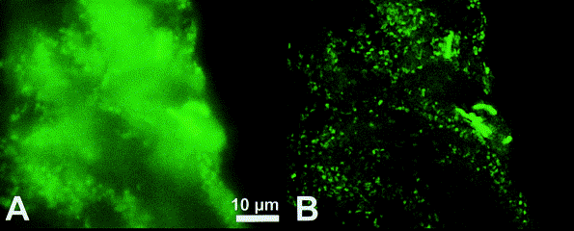
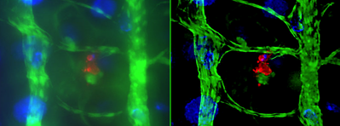
Deconvolution
Manz at al. J Microbiol Methods 2000, 40:125-34.
Fig. * Tissue sections of Chondrosia reniformis after hybridization with the Bacteria specific probe EUB338
AutoDeblur from Media Cybernetics

Slide 36
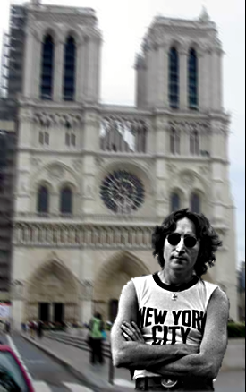
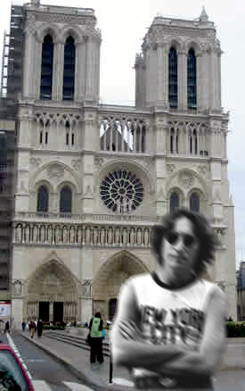
Focus

Slide 37


Slide 38
Confocal microscope
Dr. Marvin Minsky
Confocal microscope: 1957

Slide 39
Confocal microscope
Laser
Scanning
Confocal
Microscope
LASER
Light
Amplification by the
Stimulated
Emission of
Radiation

Slide 40
Confocal microscope
Dichroic
Mirror

Slide 41



Conventional / Confocal

Slide 42
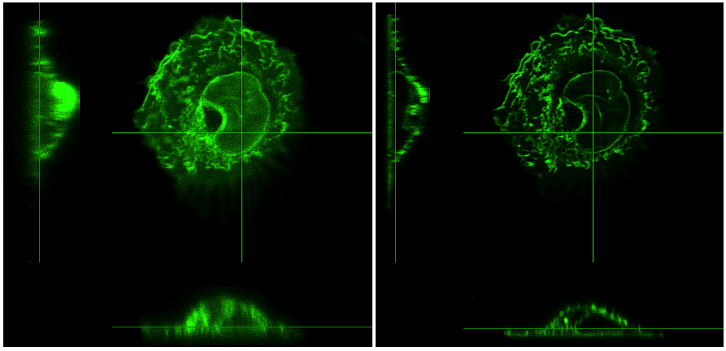
Conventional / Confocal

Slide 43
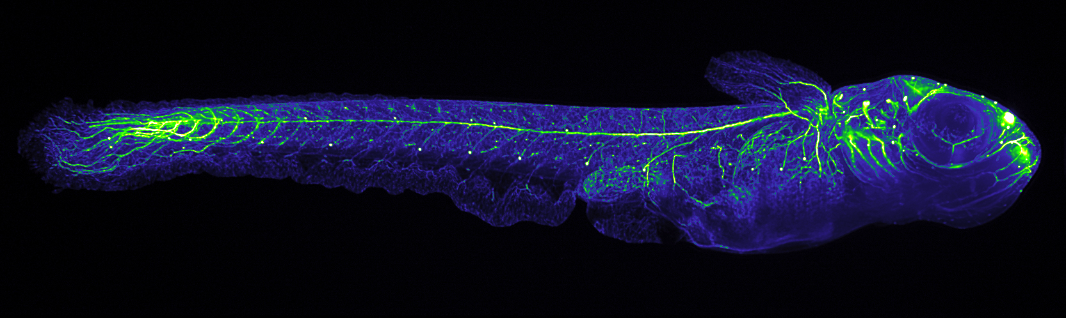
Confocal microscope
Light Sheet Microscopy
Single Plane Illumination Microscopy (SPIM)
Medaka juveniles
Philipp Keller, Stelzer Group, EMBL

Slide 44
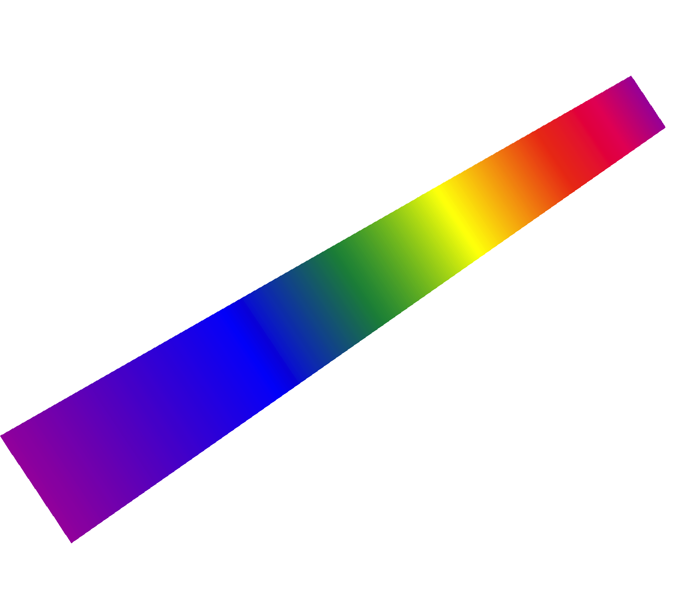
Confocal Olympus FV1000
453 nm
488 nm
515 nm
Hooke 1670
Hexadimensional
(space- time)
Microscopy
543 nm
633 nm
Fluorescence
- Lifetime
Z Compensate System
λ
Z
Y
X
Time

Slide 45
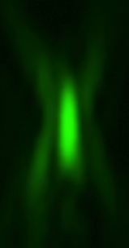
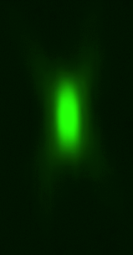
Confocal PSF
WF
CF

Slide 46
Fluorescence
Jablonski
diagram
400 nm
450 nm

Slide 47
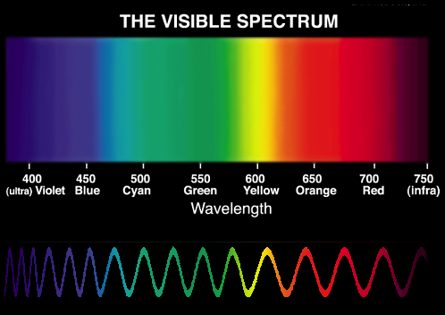
Wavelength and Light Properties
(λ)
575 nm
High
Energy
Low
Energy
E = h c / λ
0,5* *2

Slide 48
Multiphoton exitation
Jablonski
diagram
400 nm
800 nm
1200 nm
1200 nm
800 nm
1200 nm
450 nm
Dr. Maria Göppert-Mayer : theory of two-photon quantum transitions
(two-photon absorption and emission) 1931,

Slide 49
Temporal photon concentration
Wavelength Tunability
LASER
500 nm
Pulsed LASER
1000 nm
1200 nm
800 nm
500
nm
800
1200
nm

Slide 50

Spatial photon concentration
Prof. Watt W. Webb et al.
Two-photon laser scanning
fluorescence microscopy: 1990

Slide 51
Confocal / Multiphoton

Slide 52
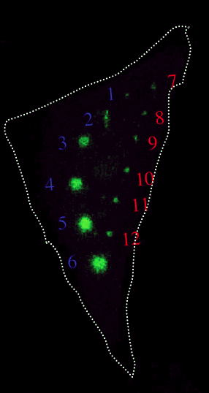
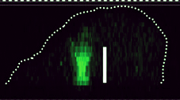

Photoconversion
Excitation area
Luo at al. Cell Structure and Function 2006, 31: 63
Comparison of photoactivation of PA-GFP in vivo with single-photon (405 nm) and multiphoton (790 nm) laser light.

Slide 53

In VIVO Imaging
Thorsten at al. Nature 2004; 427: 159
T-cell priming by dendritic cells in lymph nodes occurs in three distinct phases

Slide 54
Conventional / Confocal / Biphoton

Slide 55


Multiphoton polarization microscopy
Anisotropic optical properties of molecules
“Biphotonic”
Laser
Linear dichroism
polarizator

Slide 56


Biphoton polarization microscopy
G-proteins orientation
Base line
+ Norepinephrine
Cell expressing GAP43-CFP-Gαi2 and α2a-adrenergic receptor
Lazar J et al. Nat Methods. 2013
Two-photon polarization microscopy reveals protein structure and function

Slide 57
Magnifying
B
F
F
A₁
A
O
B₁

Slide 58
Diffraction
))))))))
)))))))))))))
)))))))))))))
)))))))))))))

Slide 59


Diffraction
Airy disk

Slide 60

Resolution
?
?

Slide 61


Resolution
Abbe diffraction limit
D = 0.2 µm
Abbe Resolution_{x,y} = λ/2NA
Numerical Aperture
NA = n•sin(θ)
n - refractive index of the imaging medium ( air, oil)
θ - aperture angle (1,4 in the best case)

Slide 62



Förster Resonance Energy Transfer (FRET)
Molecular Basis
YFP
YFP
CFP
CFP
FRET
1-10 nm

Slide 63
Confocal Olympus FV1000
453 nm
488 nm
515 nm
Hooke 1670
Hexadimensional
(space- time)
Microscopy
543 nm
633 nm
Fluorescence
- Lifetime
Z Compensate System
λ
Z
Y
X
Time

Slide 64
Fluorescence
Jablonski
diagram
400 nm
450 nm

Slide 65
Fluorescence (true)
Jablonski
diagram
400 nm
450 nm

Slide 66
Fluorescence-Lifetime Imaging (FLIM)
Time (ns)
FL1
F
FL2
FL1
FRET
1-10 nm
Free
Coupled

Slide 67


Fluorescence-Lifetime Imaging (FLIM)
Molecular Interactions
Intracellular pH
Alpy F et al. J Cell Sci. 2013
STARD3 or STARD3NL and VAP form a novel molecular tether between late endosomes and the ER.
Lin HJ et al. Cytometry A. 2003
Fluorescence lifetime-resolved pH imaging of living cells.

Slide 68
Near-field optical microscopy

Slide 69
Near-field optical microscopy
special ($)1.78 refractive index coverslips
special ($ $) 1.78 refractive index oil
special ($ $ $) objective 100x 1.65NA

Slide 70
Near-field optical microscopy

Slide 71
Total internal reflection
Evanescent wave
≈100 nm
The critical angle is the angle of incidence above which the total internal reflectance occurs
Θ₂
Θ₁

Slide 72

Total Internal Reflection Fluorescence Microscopy (TIRF)
Up to 20 nm of lateral resolution and 2–5 nm of axial resolution
5 µm
1 µm
McKinney et al.Nature Methods 6, 131 - 133 (2009)

Slide 73
Structured Illumination Microscopy
The Moire effect
+
=
-
=

Slide 74

Structured Illumination Microscopy

Slide 75

Structured Illumination Microscopy
Up to 100 nm of lateral resolution and 300 nm of axial resolution

Slide 76
Switch to nonfluorescente state
Fluorescence
Triplet state
Non fluorescent
400 nm

Slide 77
Super-resolution
Optical Fluctuation Imaging (SOFI)
Emission
Desactivation
PA-GFP
Emission
Desactivation

Slide 78
Super-resolution
Optical Fluctuation Imaging (SOFI)
t₁
:
:
:
:
t_{n}
t₁
:
:
:
:
t_{n}
Fast, background-free, 3D super-resolution optical fluctuation imaging (SOFI).
Dertinger T, Colyer R, Iyer G, Weiss S, Enderlein J.
Proc Natl Acad Sci U S A. 2009
The second-order correlation function

Slide 79







Super-resolution
Optical Fluctuation Imaging (SOFI)
Up to 50 nm of lateral resolution and ? nm of axial resolution
Fast, background-free, 3D super-resolution optical fluctuation imaging (SOFI).
Dertinger T, Colyer R, Iyer G, Weiss S, Enderlein J.
Proc Natl Acad Sci U S A. 2009

Slide 80
Super-resolution
Bleaching Assisted Localization Microscopy(BALM)
t₁
:
:
:
:
t_{n}
t₁
:
:
:
:
t_{n}
Fast, Bleaching/blinking assisted localization microscopy for
superresolution imaging using standard fluorescent molecules.
Burnette DT, Sengupta P, Dai Y, Lippincott-Schwartz J, Kachar B.
Proc Natl Acad Sci U S A. 2011 Dec 27;108(52):21081-6

Slide 81





Super-resolution
Bleaching Assisted Localization Microscopy(BALM)
Up to 50 nm of lateral resolution and ? nm of axial resolution
Fast, Bleaching/blinking assisted localization microscopy for
superresolution imaging using standard fluorescent molecules.
Burnette DT, Sengupta P, Dai Y, Lippincott-Schwartz J, Kachar B.
Proc Natl Acad Sci U S A. 2011 Dec 27;108(52):21081-6

Slide 82
Stimulated emission depletion
520 nm
488 nm
+
=
doughnut-shape

Slide 83

Stimulated emission depletion
(STED)
Up to 50 nm of lateral resolution and 500 nm of axial resolution

Slide 84

Stimulated emission depletion 3X
X Y
+
=
X Y Z

Slide 85

Stimulated emission depletion
(STED 3X)
Up to 50 nm of lateral and axial resolution

Slide 86
Fluorescence Localization Microscopy

Slide 87
Fluorescence Photoactivation Localization
Microscopy
Activation
Emission
PA-GFP
PA-GFP
PA-GFP
Localization
(calculation)
Photobleaching

Slide 88
Fluorescence Localization Microscopy

Slide 89

Fluorescence Photoactivation Localization
Microscopy (PALM)
Hess, S.T., T.P. Girirajan, and M.D. Mason. 2006. Ultra-high resolution imaging by fluorescence photoactivation localization microscopy. Biophys J. 91(11):

Slide 90

Fluorescence Photoactivation Localization
Microscopy
Up to 30 nm of lateral resolution and 150 nm of axial resolution
ZHUANG LAB/HARVARD UNIV.

Slide 91
Switch to nonfluorescente state
Ground state depletion
Fluorescence
Jablonski
diagram
400 nm
Triplet state
550 nm
Non fluorescent
Thiols
(R-SH)
600 nm
Ground state

Slide 92
Ground State Depletion Microscopy
direct Stochastic Optical Reconstruction Microscopy
Total Deactivation
(Ground State Depletion)
Stochastic Activation
FITC
FITC
FITC
Emission
Localization
(calculation)

Slide 93

Ground State Depletion Microscopy

Slide 94

Biplan Localization Microscopy
Cylindrical
lens
+ 400 nm
0
- 400 nm

Slide 95

Biplan Localization Microscopy
Vutara, Inc..

Slide 96



Super-Resolution Microscopy
gSTED 3X
Biplan
___
50
___
100
___
50
2013
_____
Schermelleh L et al. J Cell Biol 2010;190:165-175

Slide 97
Merci !
Merci !

Slide 98
http://www.research.utah.edu/advanced-microscopy/education/index.html
http://www.olympusmicro.com/primer/anatomy/anatomy.html
http://www.microscopyu.com/articles/formulas/
http://zeiss-campus.magnet.fsu.edu/index.html

