Slide 1

Les besoins
(Technologiquement parlant)
SUPER-RESOLUTION
Second-Harmonic
Lambda Imaging
Confocal
Motorized stage
Pulsed IR-laser
( Multiphoton exitation)
— Intracellular Tracking
— Uncaging & Photostimulation
— Low photodamage
— “Spectral freedom” (tunable)
etc. etc etc
FLIM - Detector
( Fluorescence lifetime imaging)
—Molecular interraction (FRET)
— intracellular pH
etc. etc etc
CO2 chamber
White laser
Z- Drift Compensation

Slide 2

Fluorescence-Lifetime Imaging (FLIM)
Time (ns)
FL1
F
FL2
FL1
FRET
1-10 nm
Free
Coupled

Slide 3

Fluorescence
Jablonski
diagram
400 nm
450 nm

Slide 4
Fluorescence (true)
Jablonski
diagram
400 nm
450 nm

Slide 5
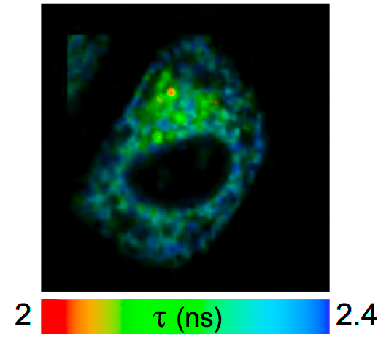
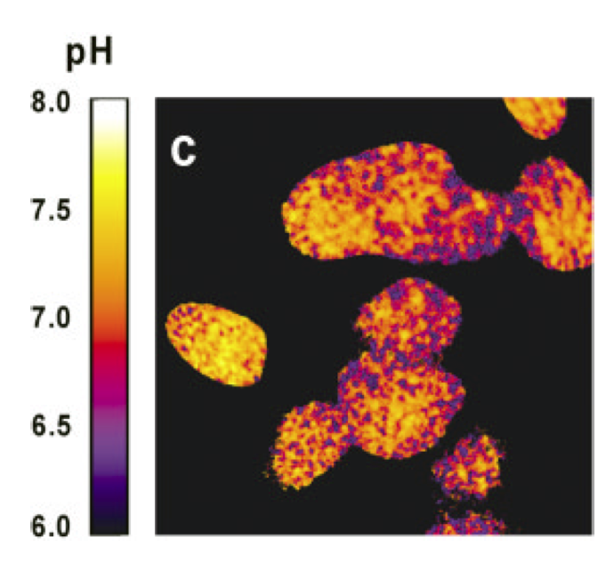
Fluorescence-Lifetime Imaging (FLIM)
Molecular Interactions
Intracellular pH
Alpy F et al. J Cell Sci. 2013
STARD3 or STARD3NL and VAP form a novel molecular tether between late endosomes and the ER.
Lin HJ et al. Cytometry A. 2003
Fluorescence lifetime-resolved pH imaging of living cells.

Slide 6
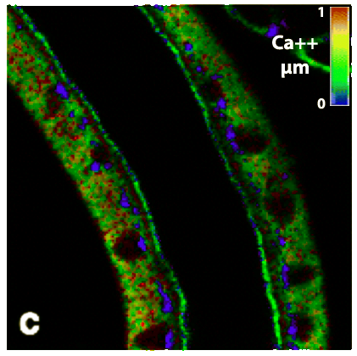
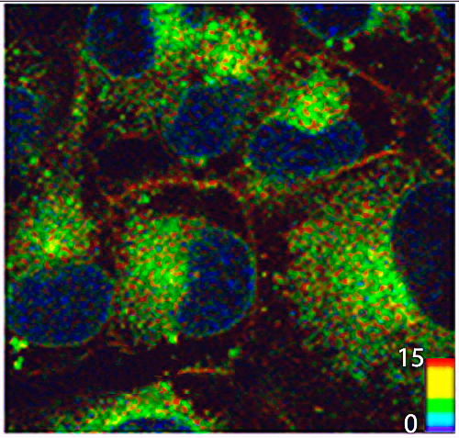
Fluorescence-Lifetime Imaging (FLIM)
Intracellular Ca⁺⁺
Drugs release
Sagolla K et al. Anal Bioanal Chem. 2013
Time-resolved fluorescence microscopy for quantitative Ca2+ imaging in living cells.
Basuki JS et al. Nano. 2013
Using fluorescence lifetime imaging microscopy to monitor theranostic nanoparticle uptake and intracellular doxorubicin release.

Slide 7
Multiphoton exitation
Jablonski
diagram
400 nm
800 nm
1200 nm
1200 nm
800 nm
1200 nm
450 nm
Dr. Maria Göppert-Mayer : theory of two-photon quantum transitions
(two-photon absorption and emission) 1931,

Slide 8

Femtosecond pulsed laser & Spatial photon concentration
Prof. Watt W. Webb et al.
Two-photon laser scanning
fluorescence microscopy: 1990

Slide 9
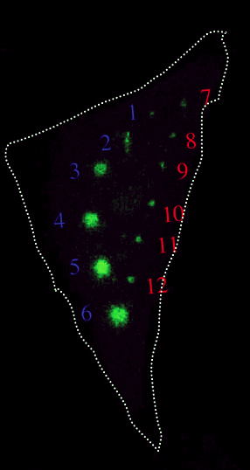
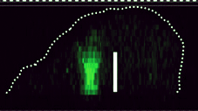
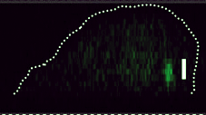
Photoconversion
Excitation area
Luo at al. Cell Structure and Function 2006, 31: 63
Comparison of photoactivation of PA-GFP in vivo with single-photon (405 nm) and multiphoton (790 nm) laser light.

Slide 10
Conventional / Confocal / Biphoton

Slide 11
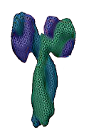

Multiphoton polarization microscopy
Anisotropic optical properties of molecules
“Biphotonic”
Laser
Linear dichroism
polarizator

Slide 12
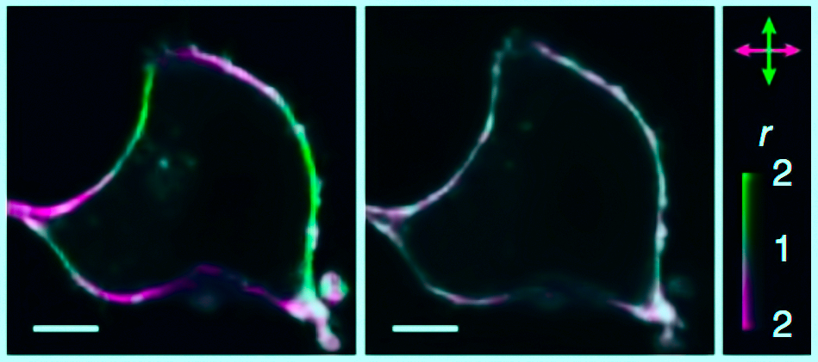
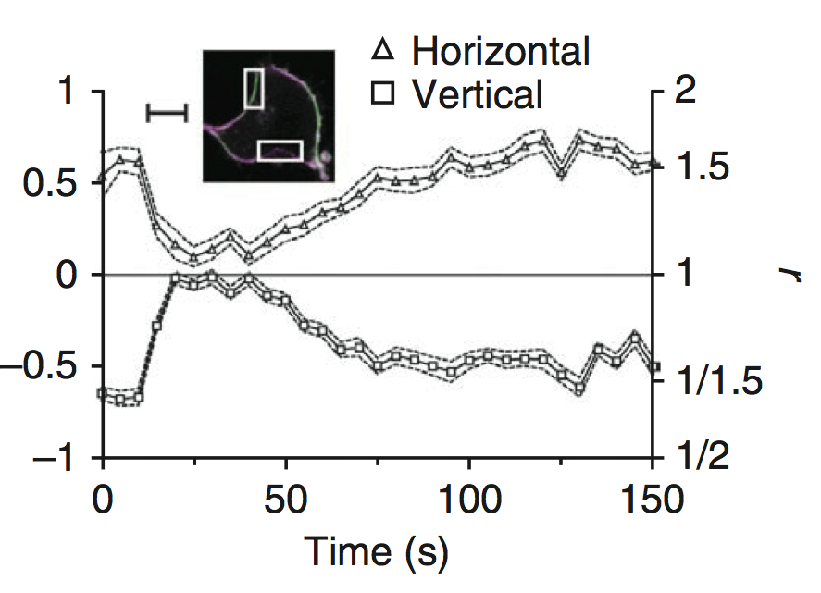
Biphoton polarization microscopy
G-proteins orientation
Base line
+ Norepinephrine
Cell expressing GAP43-CFP-Gαi2 and α2a-adrenergic receptor
Lazar J et al. Nat Methods. 2013
Two-photon polarization microscopy reveals protein structure and function

Slide 13
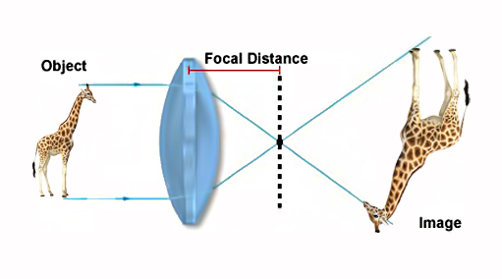
Magnifying
B
F
F
A₁
A
O
B₁

Slide 14
Diffraction
))))))))
)))))))))))))
)))))))))))))
)))))))))))))

Slide 15
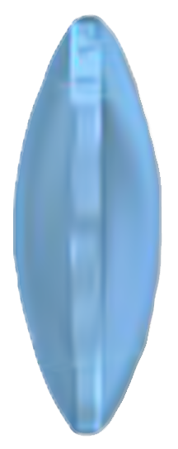

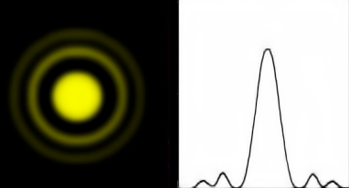
Diffraction
Airy disk

Slide 16
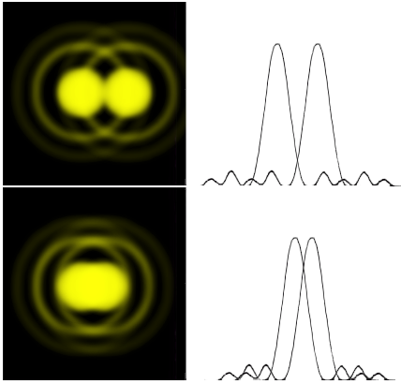
Resolution
?
?

Slide 17
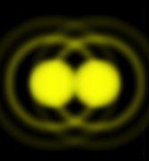
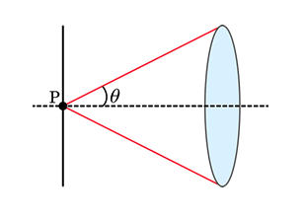
Resolution
Abbe diffraction limit
D = 0.2 µm
Abbe Resolution_{x,y} = λ/2NA
Numerical Aperture
NA = n•sin(θ)
n - refractive index of the imaging medium ( air, oil)
θ - aperture angle (1,4 in the best case)

Slide 18
Near-field optical microscopy

Slide 19
Near-field optical microscopy
special ($)1.78 refractive index coverslips
special ($ $) 1.78 refractive index oil
special ($ $ $) objective 100x 1.65NA

Slide 20
Near-field optical microscopy

Slide 21
Total internal reflection
Evanescent wave
≈100 nm
The critical angle is the angle of incidence above which the total internal reflectance occurs
Θ₂
Θ₁

Slide 22
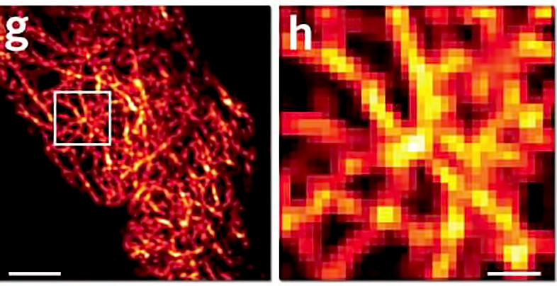
Total Internal Reflection Fluorescence Microscopy (TIRF)
Up to 20 nm of lateral resolution and 2–5 nm of axial resolution
5 µm
1 µm
McKinney et al.Nature Methods 6, 131 - 133 (2009)

Slide 23
Structured Illumination Microscopy
The Moire effect
+
=
-
=

Slide 24

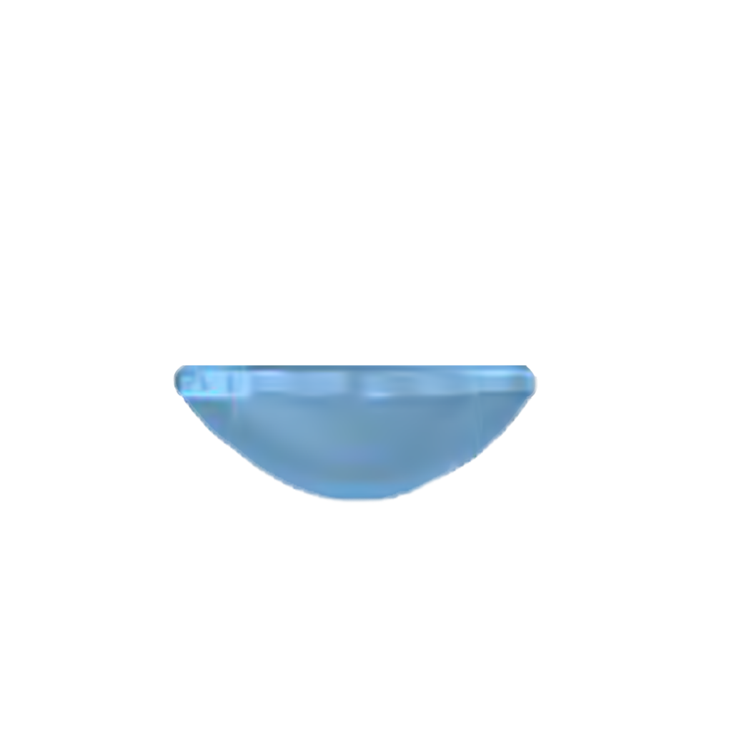
Structured Illumination Microscopy

Slide 25
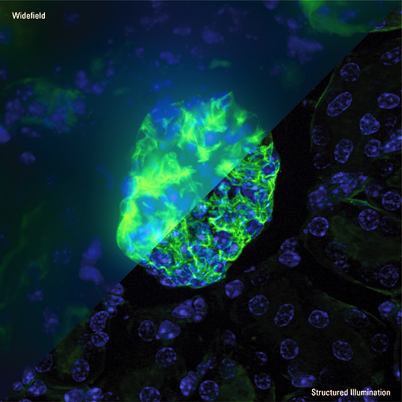
Structured Illumination Microscopy
Up to 100 nm of lateral resolution and 300 nm of axial resolution

Slide 26
Switch to nonfluorescente state
Fluorescence
Jablonski
diagram
Triplet state
550 nm
Non fluorescent
600 nm

Slide 27
Super-resolution
Optical Fluctuation Imaging (SOFI)
Emission
Desactivation
PA-GFP
Emission
Desactivation

Slide 28
Super-resolution
Optical Fluctuation Imaging (SOFI)
t₁
:
:
:
:
t_{n}
t₁
:
:
:
:
t_{n}
Fast, background-free, 3D super-resolution optical fluctuation imaging (SOFI).
Dertinger T, Colyer R, Iyer G, Weiss S, Enderlein J.
Proc Natl Acad Sci U S A. 2009
The second-order correlation function

Slide 29
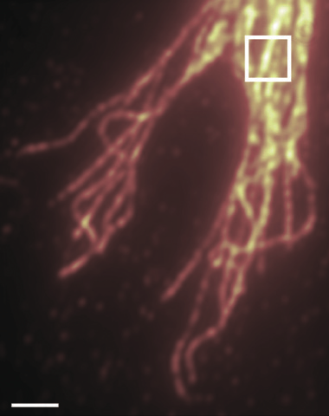
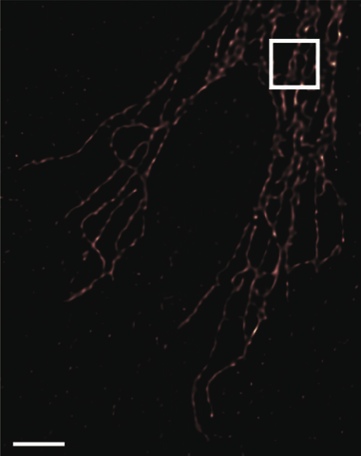
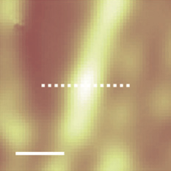
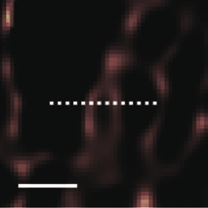



Super-resolution
Optical Fluctuation Imaging (SOFI)
Up to 50 nm of lateral resolution and ? nm of axial resolution
Fast, background-free, 3D super-resolution optical fluctuation imaging (SOFI).
Dertinger T, Colyer R, Iyer G, Weiss S, Enderlein J.
Proc Natl Acad Sci U S A. 2009

Slide 30
Super-resolution
Bleaching Assisted Localization Microscopy(BALM)
t₁
:
:
:
:
t_{n}
t₁
:
:
:
:
t_{n}
Fast, Bleaching/blinking assisted localization microscopy for
superresolution imaging using standard fluorescent molecules.
Burnette DT, Sengupta P, Dai Y, Lippincott-Schwartz J, Kachar B.
Proc Natl Acad Sci U S A. 2011 Dec 27;108(52):21081-6

Slide 31
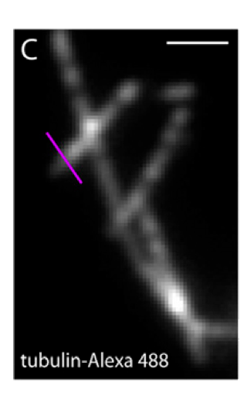
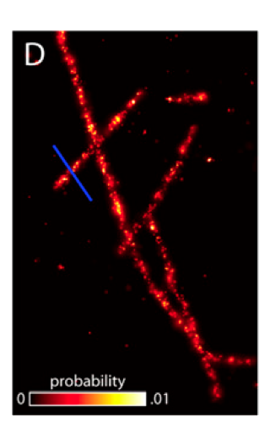



Super-resolution
Bleaching Assisted Localization Microscopy(BALM)
Up to 50 nm of lateral resolution and ? nm of axial resolution
Fast, Bleaching/blinking assisted localization microscopy for
superresolution imaging using standard fluorescent molecules.
Burnette DT, Sengupta P, Dai Y, Lippincott-Schwartz J, Kachar B.
Proc Natl Acad Sci U S A. 2011 Dec 27;108(52):21081-6

Slide 32
Fluorescence Localization Microscopy

Slide 33
Fluorescence Photoactivation Localization
Microscopy
Stochastic Activation
Emission
PA-GFP
PA-GFP
PA-GFP
Localization
(calculation)
Total Photobleaching

Slide 34
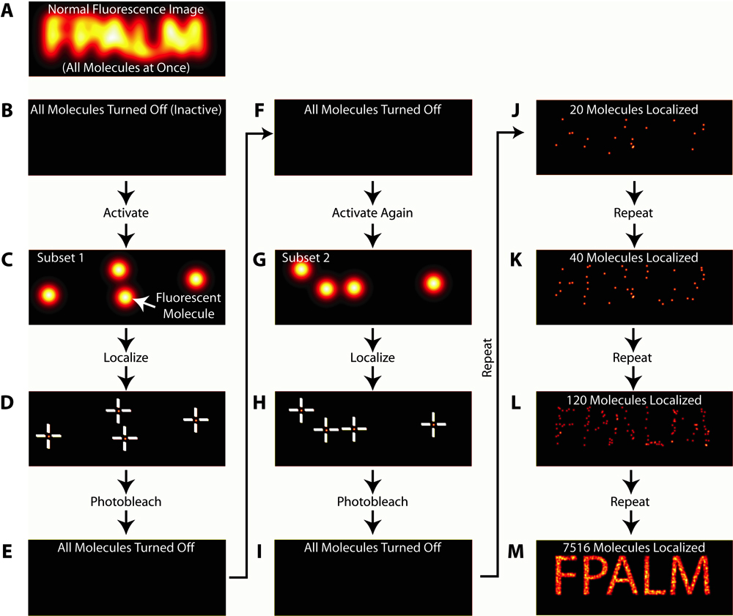
Fluorescence Photoactivation Localization
Microscopy (PALM)
Hess, S.T., T.P. Girirajan, and M.D. Mason. 2006. Ultra-high resolution imaging by fluorescence photoactivation localization microscopy. Biophys J. 91(11):

Slide 35
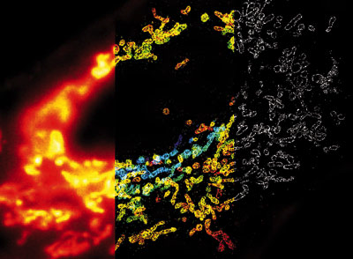
Fluorescence Photoactivation Localization
Microscopy
Up to 30 nm of lateral resolution and 150 nm of axial resolution
ZHUANG LAB/HARVARD UNIV.

Slide 36
Switch to nonfluorescente state
Ground state depletion
Fluorescence
Jablonski
diagram
400 nm
Triplet state
550 nm
Non fluorescent
Thiols
(R-SH)
600 nm
Ground state

Slide 37
Ground State Depletion Microscopy
direct Stochastic Optical Reconstruction Microscopy
Total Deactivation
(Ground State Depletion)
Stochastic Activation
FITC
FITC
FITC
Emission
Localization
(calculation)

Slide 38
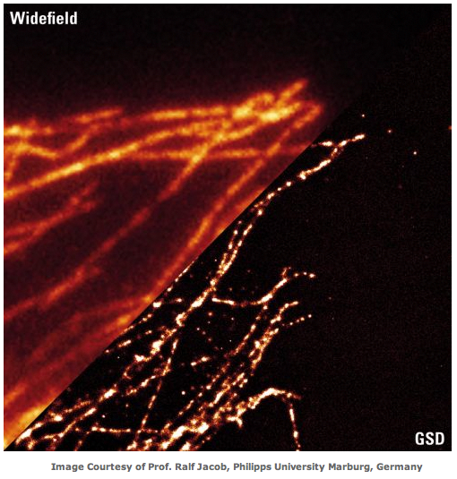
Ground State Depletion Microscopy

Slide 39

Stimulated emission depletion
520 nm
488 nm
+
=
doughnut-shape

Slide 40
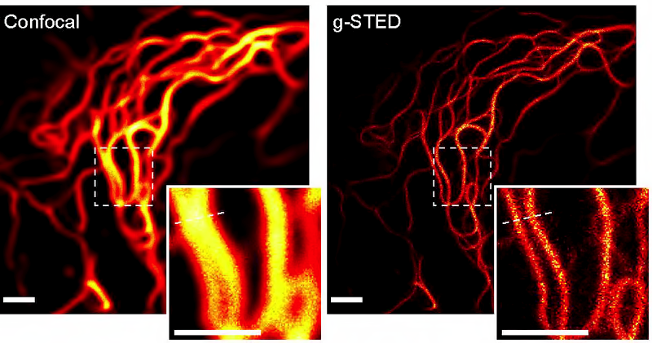
Stimulated emission depletion
(STED)
Up to 50 nm of lateral resolution and 500 nm of axial resolution

Slide 41

Point Spread Function
Z
Working distance

Slide 42
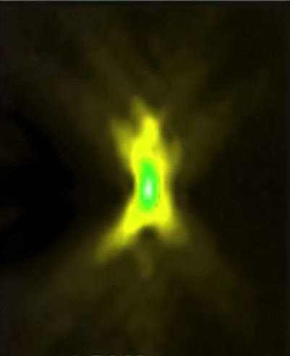
Point Spread Function
PSF describes the imaging system response to a point input
Z
In microscopy the point spread functions is asymmetric due to lens imperfections

Slide 43
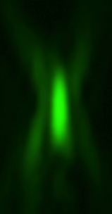
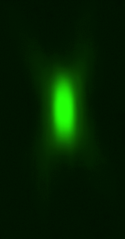
Confocal PSF
WF
CF

Slide 44
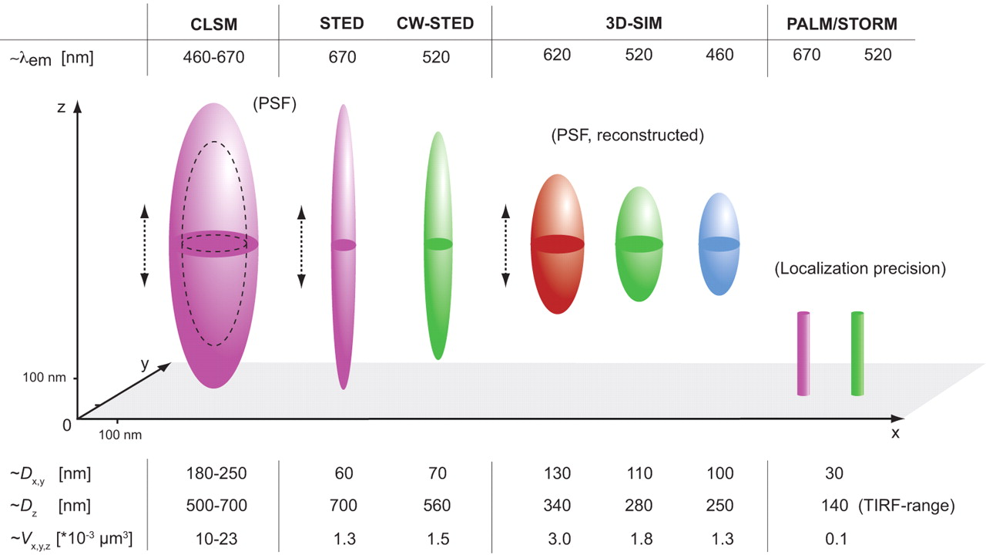
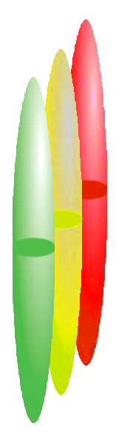

Super-Resolution Microscopy
gSTED 3X
Biplan
___
50
___
100
___
50
2013
_____
Schermelleh L et al. J Cell Biol 2010;190:165-175

Slide 45
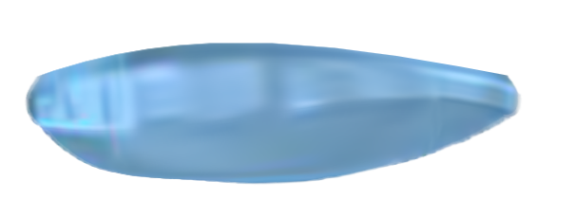
Biplan Localization Microscopy
Cylindrical
lens
+ 400 nm
0
- 400 nm

Slide 46
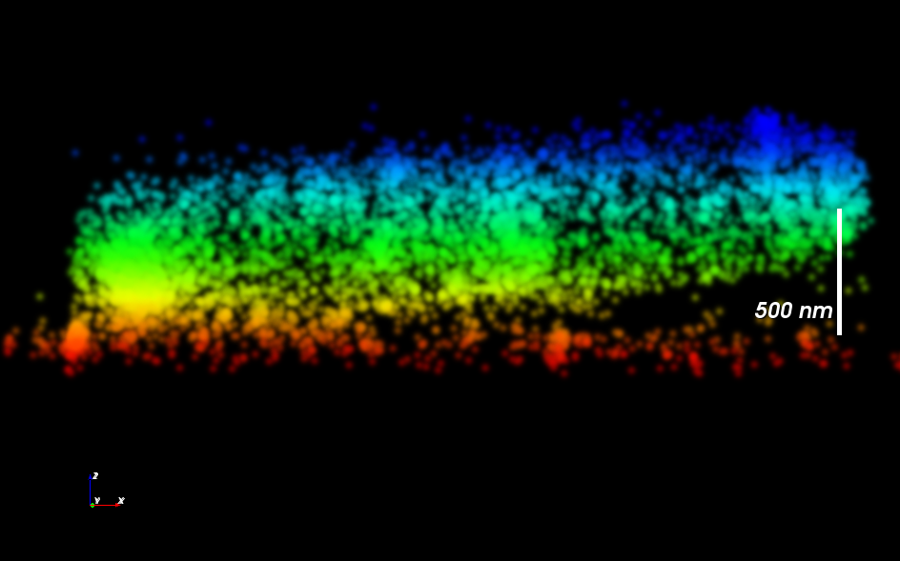
Biplan Localization Microscopy
Vutara, Inc..

Slide 47
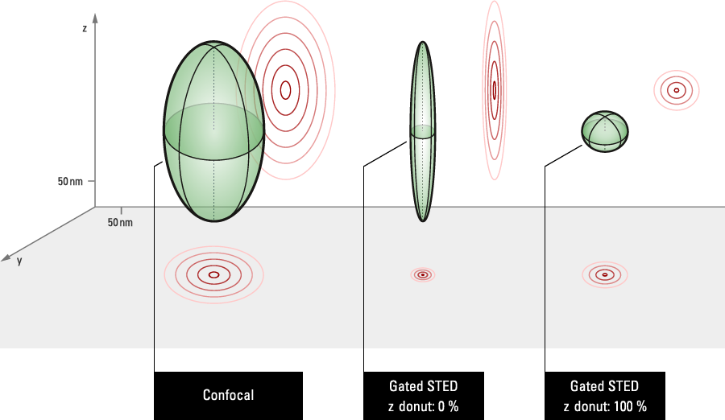
Stimulated emission depletion 3X
X Y
+
=
X Y Z

Slide 48
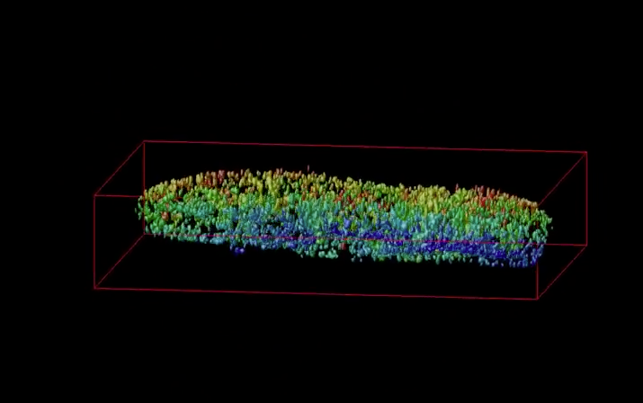
Stimulated emission depletion
(STED 3X)
Up to 50 nm of lateral and axial resolution

Slide 49
Super-Resolution Microscopy
gSTED 3X
Biplan
___
50
___
100
___
50
2013
_____
Schermelleh L et al. J Cell Biol 2010;190:165-175

